Slide 1
Java Basics
Università di Modena e Reggio Emilia
Prof. Nicola Bicocchi (nicola.bicocchi@unimore.it)

Slide 2
Timeline
1991: SUN develops a language for cable TV boxes
1996: Java 1
1996: Netscape browser supports Java. Popularity grows
1998: Java 2 (major API increase)
2005: Java 5 (major enhancements)
2014: Java 8 LTS (support until 2030)
2018: Java 11 LTS (support until 2026)
2021: Java 17 LTS (support until 2029)
https://en.wikipedia.org/wiki/Java_version_history

Slide 3
Features
Portable
Write once, run everywhere
Translated to bytecode
Pure object-oriented language
Statically typed
Exceptions as a pervasive mechanism
Shares syntax elements w/ C++ (reduced learning curve)
Garbage collection

Slide 4
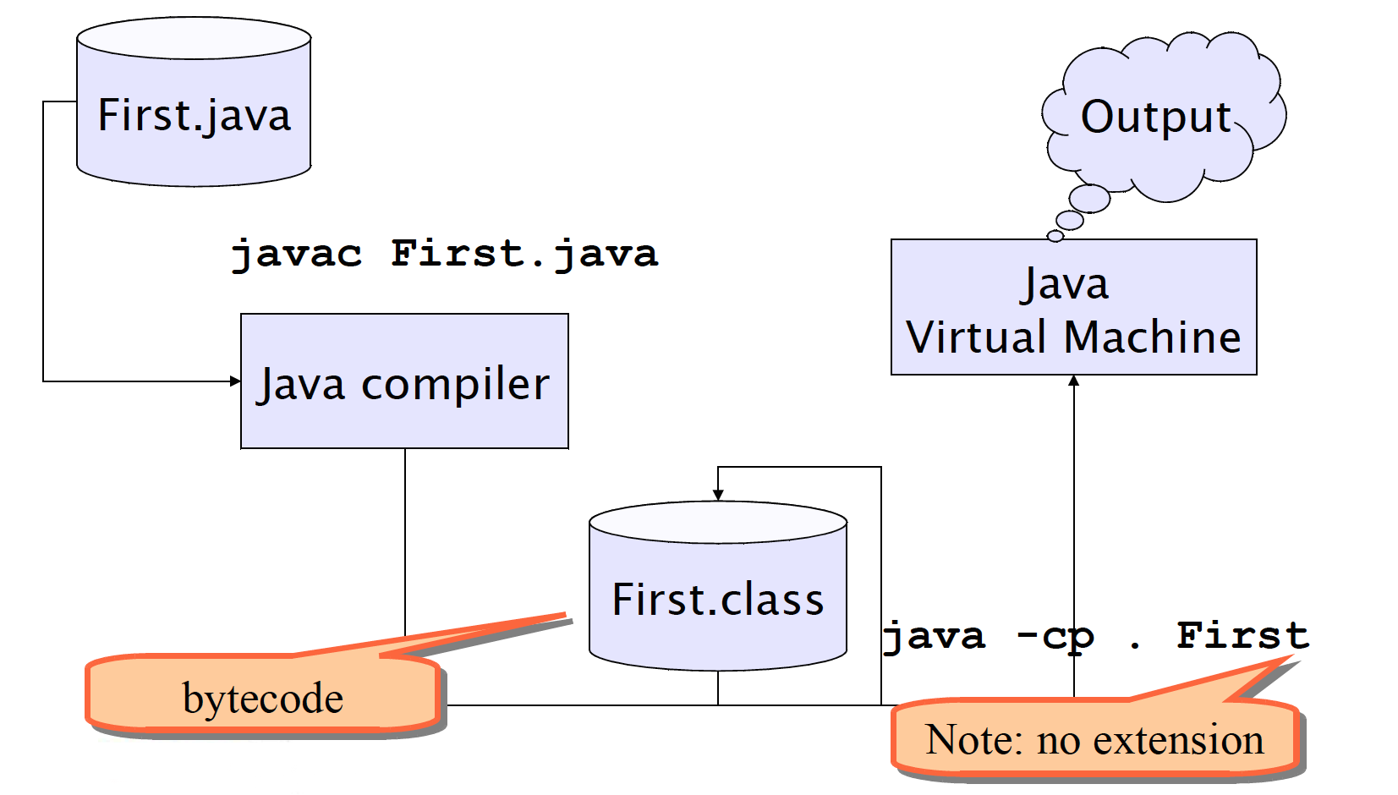
Building and running

Slide 5
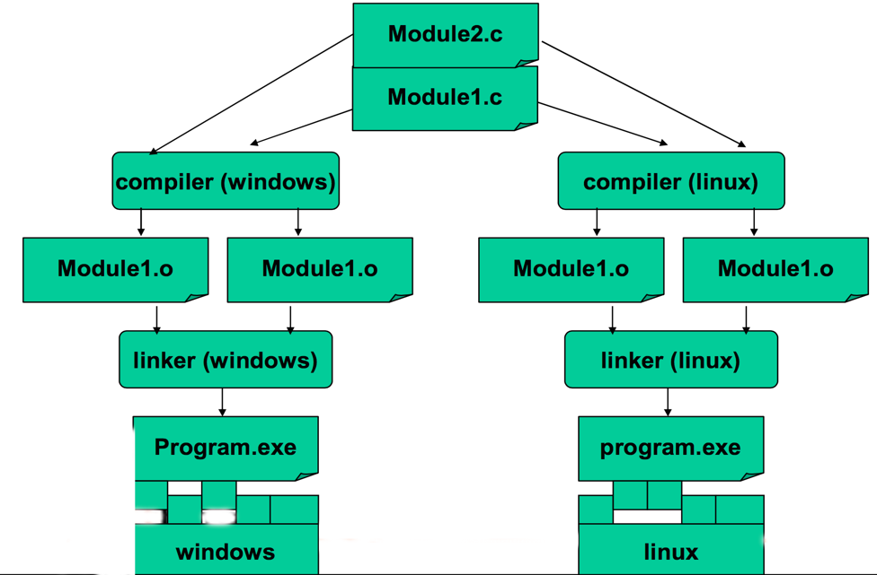
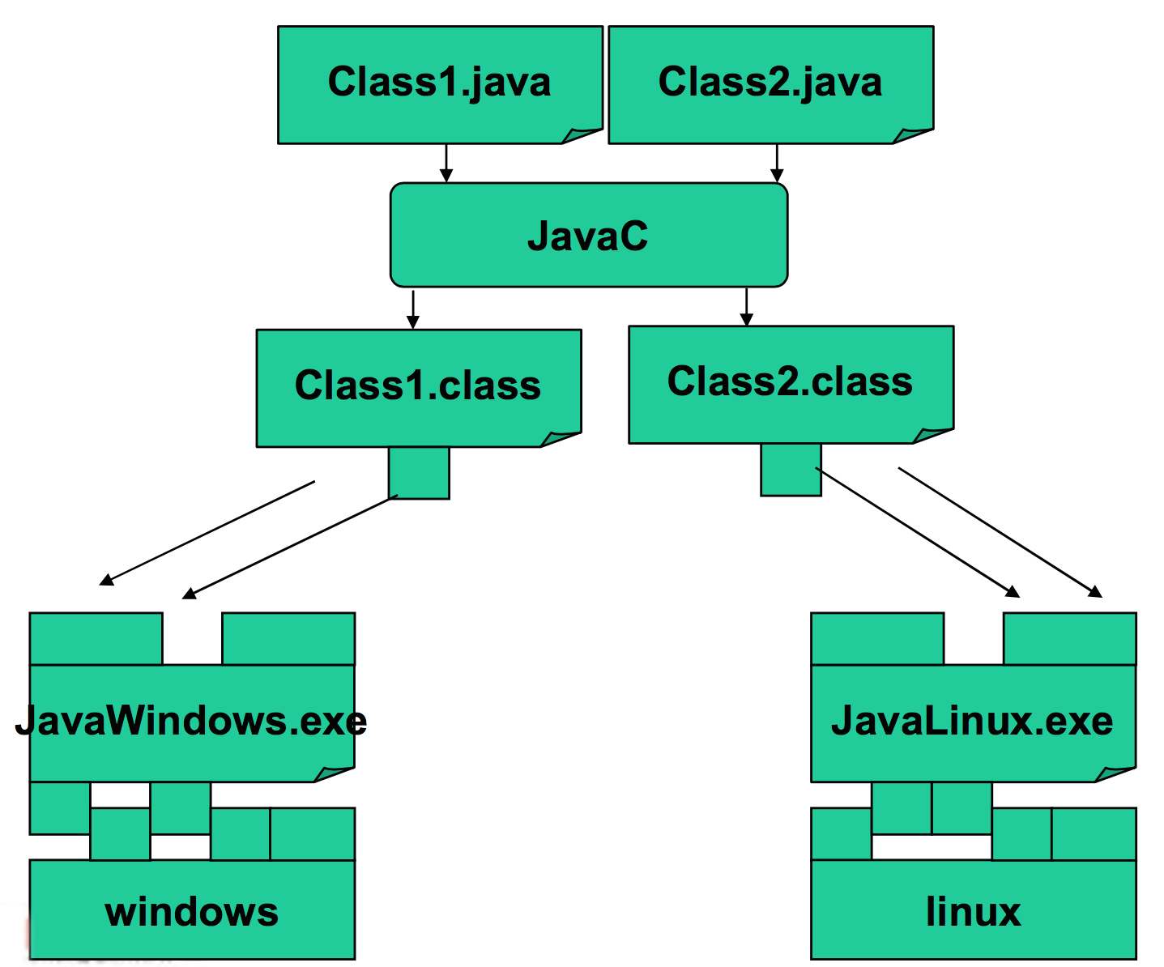
Compiled vs Interpreted

Slide 6
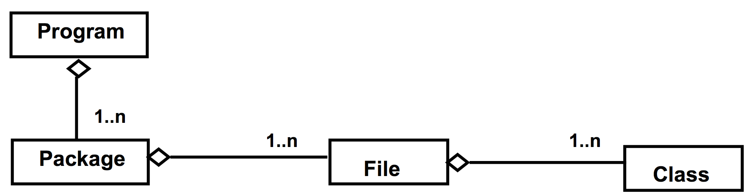
Program, files and classes
A program is made of one or more packages, containing one or more files
A file contains one public class and, optionally, multiple private classes. The file name must be equal to the public class name.

Slide 7
public static void main(String[] args)
In Java there are no functions, but only methods within classes
The execution of a Java program starts from a special method:
public static void main(String[] args) {
…
}

Slide 8
Basic concepts

Slide 9
Comments
C-style comments (multi-lines)
/*
* this comment is so long
* that it needs two lines
*/
Comments on a single line
// comment on one line

Slide 10
Code blocks and Scope
Java code blocks are the same as in C language
Each block is enclosed by braces { } and starts a new scope for the variables
Variables can be declared both at the beginning and in the middle of block code
for (int i=0; i<10; i++){
int x = 12; ... int y;
...
}

Slide 11
Control statements
Same as C
if-else
switch-case
while
do-while
for
break
continue

Slide 12
Switch-case (with chars)
public class Test {
public static void main(String args[]) {
char grade = ‘A’;
switch(grade) {
case 'A' :
System.out.println("Excellent!");
break;
case 'B' :
case 'C' :
System.out.println("Well done");
break;
case 'D' :
System.out.println("You passed");
default :
System.out.println("Invalid grade");
}
System.out.println("Your grade is " + grade);
}
}

Slide 13
Passing Parameters
Parameters are always passed by value
...they can be primitive types or object references
Note well: only the object reference is copied not the value of the object

Slide 14
Passing Parameters
public class Parameters {
public static void main(String[] args) {
Point p1 = new Point(0, 0);
Point p2 = new Point(10, 10);
System.out.println(p1);
System.out.println(p2);
swap(p1, p2);
System.out.println(p1); // 0, 0
System.out.println(p2); // 10, 10
}
public static void swap(Point p1, Point p2) {
Point tmp = p1;
p1 = p2;
p2 = tmp;
}
}
main()
heap
swap()
p1
(0, 0)
p1
p2
(10, 10)
p2

Slide 15
Passing Parameters
public class Parameters {
public static void main(String[] args) {
Point p1 = new Point(0, 0);
Point p2 = new Point(10, 10);
System.out.println(p1);
System.out.println(p2);
move(p1, p2);
System.out.println(p1); // 10, 10
System.out.println(p2); // 0, 0
}
public static void move(Point p1, Point p2) {
p1.move(10, 10);
p2.move(0, 0);
}
}
main()
move()
p1
(0, 0)
p1
p2
(10, 10)
p2

Slide 16
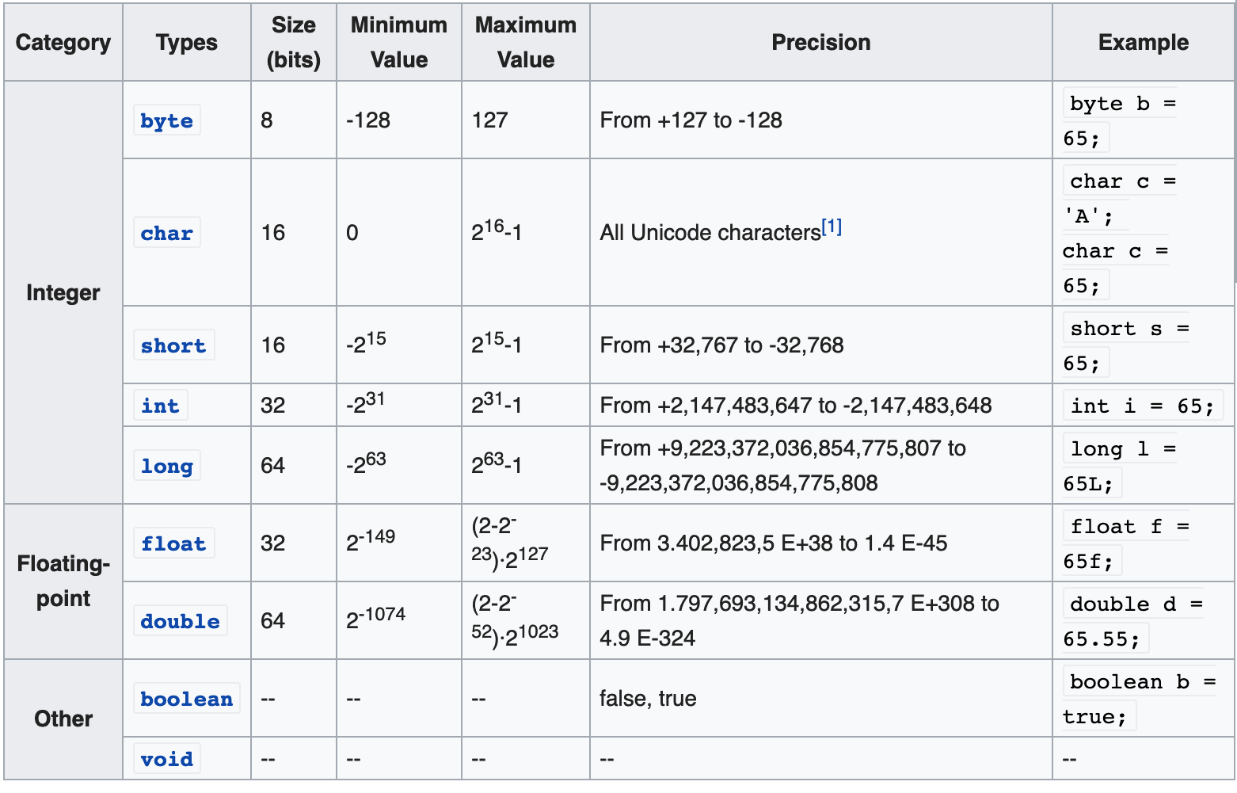
Primitive types

Slide 17
Constants
The final modifier
final float PI = 3.1415;
PI = 16.0; // ERROR, no changes allowed
Use uppercases (coding conventions)

Slide 18
Operators (integer and floating-point)
Operators follow C syntax:
arithmetical + - * / %
Relational == != > < >= <=
bitwise & | ^ ! >> <<
Logical && || ! ^
Assignment = += -= *= /= %= &= |= ^=
Increment ++ --
Chars can be treated as integers (e.g. switch)
Logical operators work ONLY on booleans. int is NOT considered a boolean value like in C

Slide 19
Coding Conventions
class ClassName {
final double PI = 3.14;
private int attributeName;
public void methodName {
int var;
if (var == 0) {
/* this is a comment*/
}
}
}
In Eclipse: CTRL+A, CTRL-I (Auto Indent)

Slide 20
Strings

Slide 21
String
No primitive type to represent string
C
char s[] = “literal”
Equivalence between string and char arrays
Java
char[] != String
java.lang.String (see Java API)

Slide 22
String
String: an immutable object representing a sequence of characters and related operations
Definition:
String name = "text";
String name = expression;
Examples:
String name = "Marty Stepp";
int x = 3, y = 5;
String point = "(" + x + ", " + y + ")";

Slide 23
Strings in memory
Strings are immutable. the JVM can optimize the amount of memory allocated for them by storing only one copy of each literal String.
When we create a String variable and assign a value to it, the JVM searches the pool for a String of equal value.
If found, the Java compiler will simply return a reference to its memory address, without allocating additional memory.
If not found, it’ll be added to the pool (interned) and its reference will be returned.
String first = "Baeldung";
String second = "Baeldung";
System.out.println(first == second); // True

Slide 24
Strings in memory
Instead, if we call the constructor of the class using the new operator, Strings are stored in memory as standard objects.
String first = new String("Baeldung");
String second = new String("Baeldung");
String third = "Baeldung";
System.out.println(first == second); // False
System.out.println(first == third); // False

Slide 25
String methods
charAt() Returns the character at the specified index (position)
compareTo() Compares two strings lexicographically
concat() Appends a string to the end of another string
contains() Checks whether a string contains a sequence of characters
endsWith() Checks whether a string ends with the specified character(s)
isEmpty() Checks whether a string is empty or not
length() Returns the length of a specified string
replace() Searches a string for a specified value, and returns a new string where the specified values are replaced
split() Splits a string into an array of substrings
startsWith() Checks whether a string starts with specified characters
substring() Returns a new string which is the substring of a specified string
valueOf() Returns the string representation of the specified value

Slide 26
equals vs ==
The == operator verifies if two references point to the same object
The equals method, instead, verifies if two objects have the same internal state
String s1, s2;
if (s1 == s2) {
System.out.println("s1 and s2 refer to the same object");
}
if (s1.equals(s2)) {
System.out.println(”s1 and s2 refer to objects having the same content!");
}

Slide 27
The + operator
It is used to concatenate 2 strings
String s = “This string” + “is made by two strings”
Works also with other types (automatically converted to string)
System.out.println(“pi = ” + 3.14);
System.out.println(“x = ” + x);

Slide 28
StringBuilder
Strings are immutable. They are never actually modified.
When two Strings are concatenated using +, the two Strings are actually discarded and a new one (containing their concatenation) is instantiated.
This process is slow
Use StringBuilder, istead!
public static void main(String[] args) {
// slow version
String s = "";
for (int i = 0; i < 100; i++) {
s += 'a';
}
System.out.println(s);
// fast version using StringBuilder
StringBuilder sb = new StringBuilder();
for (int i = 0; i < 100; i++) {
sb.append('a');
}
System.out.println(sb.toString());
}

Slide 29
Array

Slide 30
Array
An array is an ordered sequence of variables of the same type which are accessed through an index
Can contain both primitive types or object references (no actual objects!)
Array size must be defined at creation time (cannot change afterwards)

Slide 31
Array declaration
An array reference can be declared with one of these equivalent syntaxes
int[] v, int v[]
Point[] v, Point v[]
An array is an Object, must be created using new, and it is stored in the heap (as all objects)
Array declaration (e.g., int[] v) allocates memory space for the reference only, which has default value = null

Slide 32
Array creation
Using the new operator
int[] v = new int[256];
Using static initialization, filling the array with values
int[] v = {2,3,5,7,11,13};

Slide 33
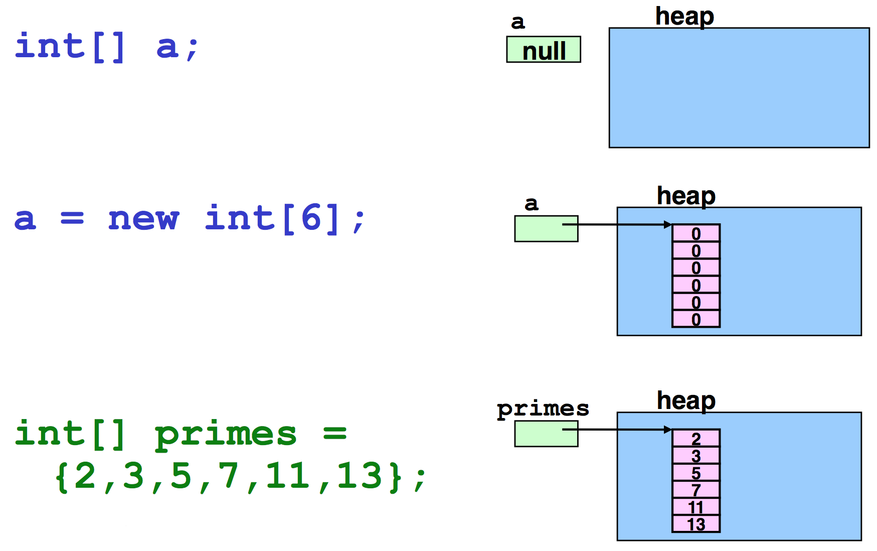
Example – Primitive types

Slide 34
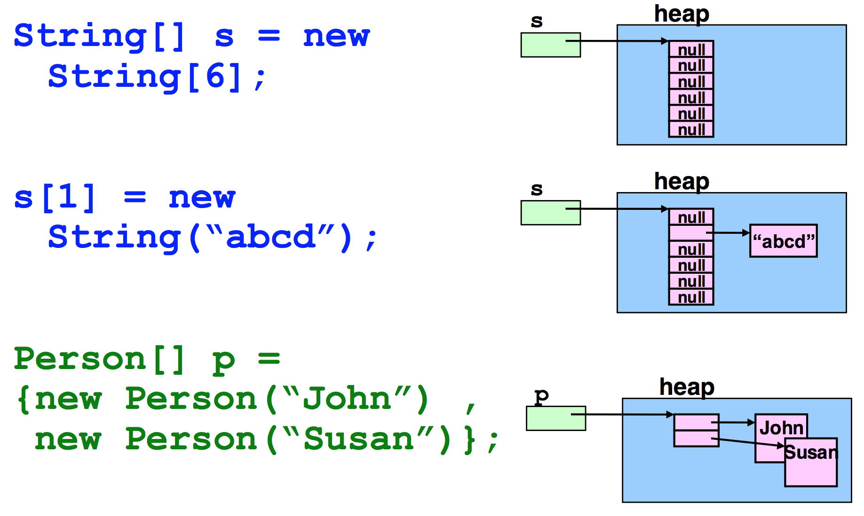
Example – Object reference

Slide 35
Operations on arrays
Java checks array bounds at runtime
int[] v = new int[16]
System.out.println(v[20])
ArrayIndexOutOfBoundsException
The length of an array (the maximum capacity of the array) is provided by the attribute length. Not to be confused with the size() method provided by the Collection interface!
for (int i=0; i < v.length; i++) {
v[i] = i;
}

Slide 36
Operations on arrays
An array reference is not a pointer to the first element of the array
It is a reference to the array object
Arithmetic on pointers does not exist in Java
// error!
int[] v1 = new int[16]; int[] v2 = v1 + 2;

Slide 37
Operations on arrays
New loop construct: for( Type var : set_expression )
set_expression can be either
an array
a class implementing Iterable (see Java Collection Framework)
The compiler can automatically loop with correct indexes
less error prone

Slide 38
For each
String[] args;
/* implicit index (also called for-each syntax) */
for(String arg: args){
System.out.println(arg);
//...
}
/* explicit index */
for(int i = 0; i < args.length; i++){
System.out.println(args[i]); //...
}

Slide 39
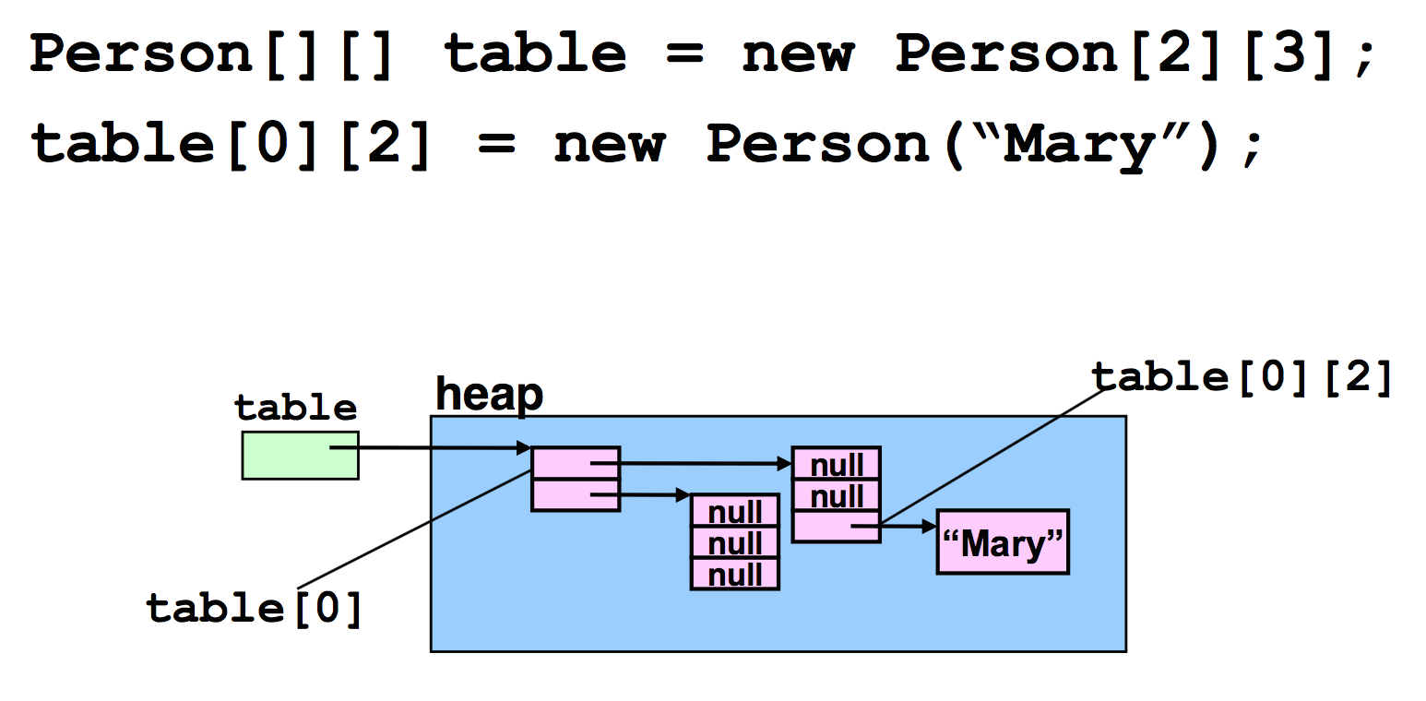
Multidimensional array
Implemented as array of arrays

Slide 40
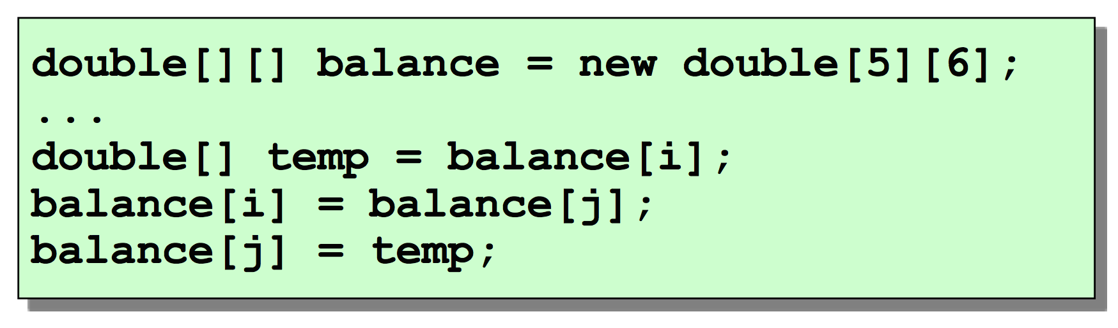
Rows and columns
As rows are not stored in adjacent positions in memory they can be easily exchanged

Slide 41
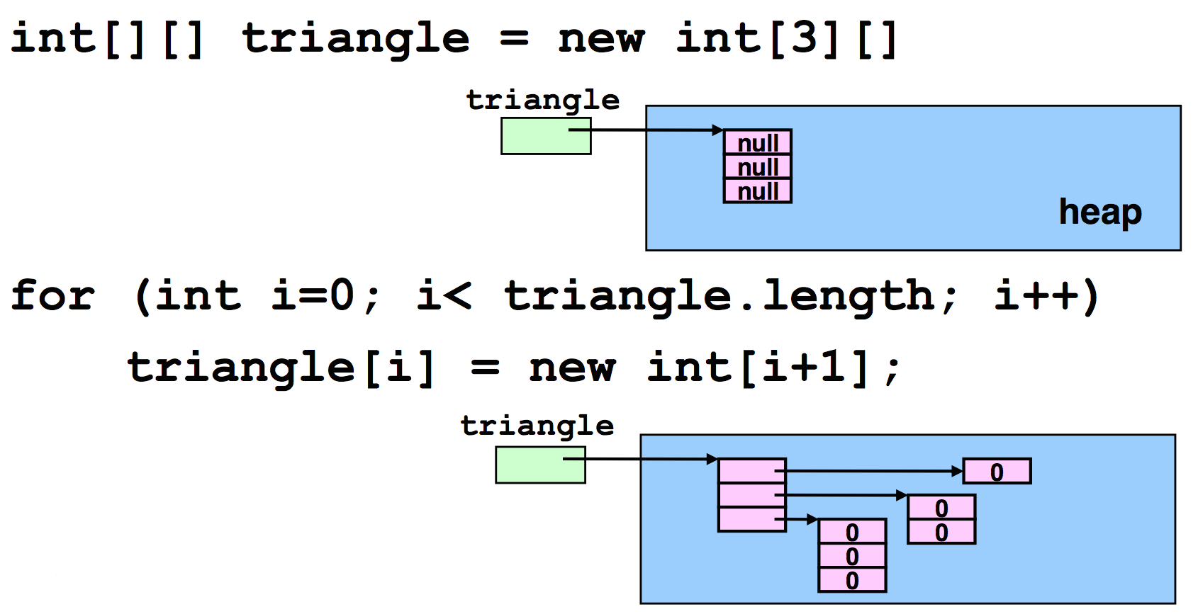
Rows with different length
A matrix (bi-dimensional array) is indeed an array of arrays

Slide 42
java.util.Arrays
Alter-ego of java.util.Collections for arrays
This class contains various methods for manipulating arrays such as sorting, searching, filling, printing or being viewed as Collections
binarySearch()
sort()
fill()
toString()
asList()

Slide 43
System.arraycopy()
System.arraycopy() copies an array from the specified source array, beginning at the specified position, to the specified position of the destination array. The number of components copied is equal to the length argument.
Advised because simple and fast!
public static void arraycopy(
Object src, int srcPos,
Object dest, int destPos,
int length)

Slide 44
Example
public static void main(String[] main) {
Random rnd = new Random();
int[] v1 = new int[10];
int[] v2 = new int[10];
Arrays.fill(v1, 15);
System.out.println("v1 = " + Arrays.toString(v1));
for (int i = 0; i < v1.length; i++) {
v1[i] = rnd.nextInt(100);
}
System.out.println("v1 = " + Arrays.toString(v1));
Arrays.sort(v1);
System.out.println("v1 = " + Arrays.toString(v1));
System.arraycopy(v1, 0, v2, 0, 10);
System.out.println("v2 = " + Arrays.toString(v2));
}
v1 = [15, 15, 15, 15, 15, 15, 15, 15, 15, 15]
v1 = [37, 48, 19, 66, 18, 41, 8, 35, 44, 16]
v1 = [8, 16, 18, 19, 35, 37, 41, 44, 48, 66]
v2 = [8, 16, 18, 19, 35, 37, 41, 44, 48, 66]

